Slide 1

DeepAuto: A Hierarchical Deep Learning Framework for Real Time Prediction in Cellular Networks Authors: Abhijeet Bhorkar, Ke Zhang, Jin Wang
October 3, 2019

Slide 2





Mobility Network Automation
Mobile Network optimization and automation is essential to improve network performance, reduce OPEX and keep up with demand, delivery & service.
Real time KPIs,
Historical counters, network alarms
AI
Predictions
Control actions
ONAP, RIC

Slide 3
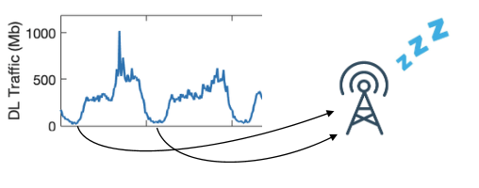
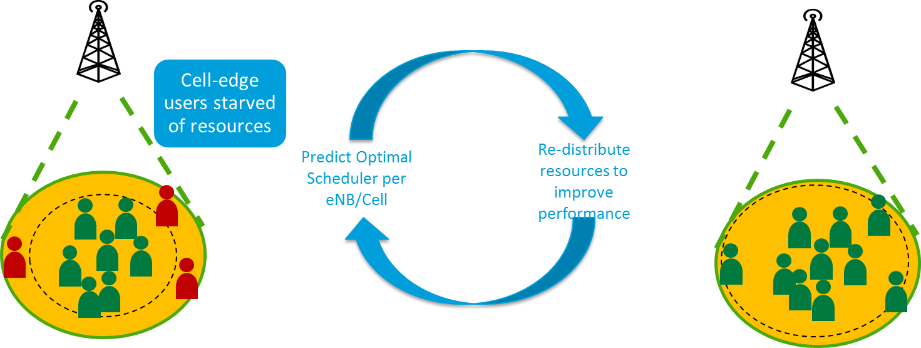
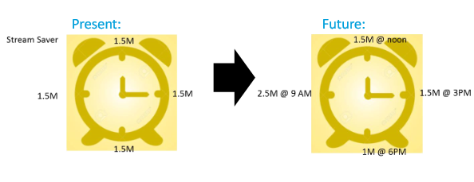
RAN Automation use cases
Energy savings (sleeping cell)
Load balancing
Scheduler optimization
Adaptive stream saver
Traffic offload
Handover optimization
Energy savings (sleeping cell)
Adaptive stream saver
Scheduler optimization

Slide 4
Goals
Design a scalable reusable accurate* prediction framework to predict RAN KPIs
Predict KPIs for different history and horizon combinations
Capture multi-scale temporal and spatial information
Framework should be able to predict real time
Include impacts of network configuration changes and external influence
More accurate estimate results in better adaptation decisions
Xuan Kelvin et al, “Can Accurate Predictions Improve Video Streaming in Cellular Network”

Slide 5


DeepAuto: Architecture of Prediction System
Coarse, longer delay data is used for mid term (hour-week) prediction.
Finer, shorter delay data is used for short term (second-mins) prediction.
15-min PM Data Collector
Long Term Predictor
(hour-week)
LTE/5G Cell
Prediction
API Gateway
Real-Time Collector
Short Term Predictor
(sec-hour)
DeepAuto
Notes:
CIM – Common Information Model

Slide 6
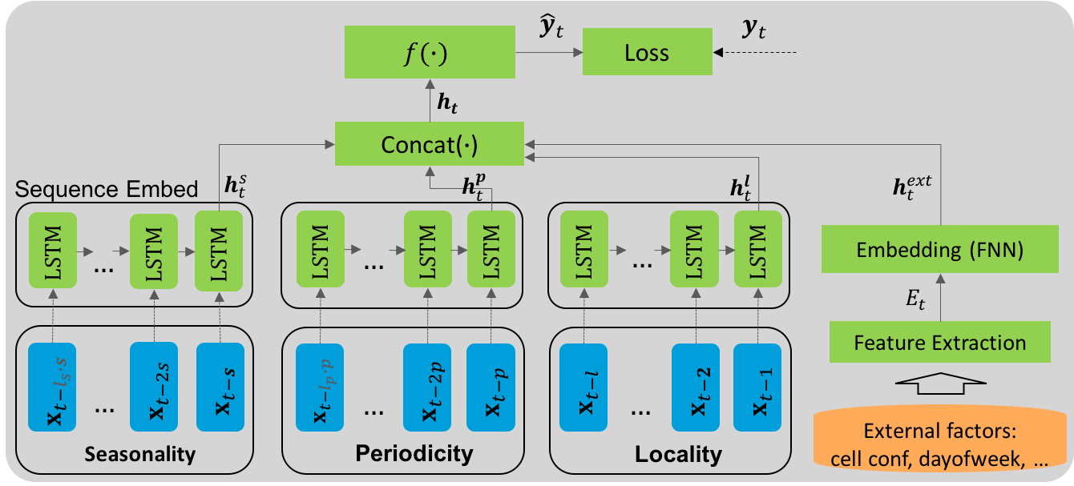
DeepAuto: Reusable prediction engine using deep learning
The objective of reusable prediction engine is to provide short-term (seconds to few mins) and long-term (hours, days, weeks) forecasts of various cell level and UE level KPIs.
The problem can be framed as time-series prediction and in general using Nonlinear Autoregressive with exogenous inputs (NARX) framework.
We have designed Long Short-Term Memory (LSTM) based framework for the prediction tasks.
LSTM frameworks have shown benefits over statistical frameworks such as Autoregressive integrated moving average (ARIMA) at the cost of increased complexity [1].
Traditional machine learning models such as random forest models cannot capture long term dependencies.
Past values of same series
Current and past values of exogeneous series
[1] LSTM network: a deep learning approach for short-term traffic forecast
Proposed LSTM based architecture for reusable analytics

Slide 7
Evaluation of DeepAuto
We illustrate our work using most important cell level KPIs including cell load prediction and radio channel quality prediction.
Key applications such as adaptive scheduler selection and cell load balancing will be enabled using cell load and channel quality KPI prediction
Cell load prediction: The objective is to predict average Cell PRB utilization in the next 1 min, 15 min and 1 hour for each cell.
Radio channel quality prediction : The objective is to predict RSRQ distribution in the next 5 mins for each cell.

Slide 8
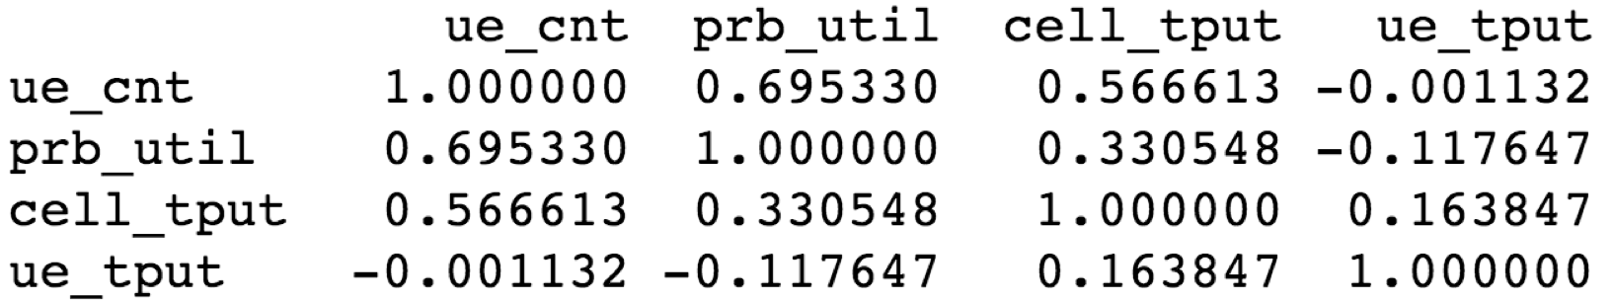
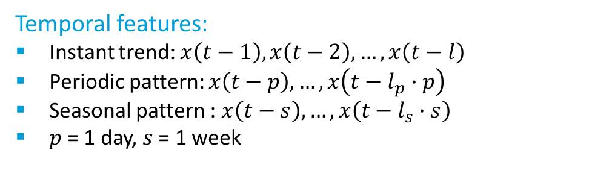
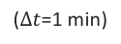
Cell Load Prediction (1)
Snapshot of the training data for cell load prediction
cell_name | timestamp | cell_prb_util_percent_dl | active_ue_dl | cell_bitrate_kbps_dl | ENODEB | EARFCN_DL | DL_CH_BANDWIDTH | MAX_TX_POWER | LATITUDE | LONGITUDE | ALTITUDE | MARKET_CLUSTER | MARKET | SW_VERSION
CAL00013_2A_1 | 5/22/2018 0:00 | 53.13 | 1.49 | 5438 | CAL00013 | 2200 | 10000 | 490 | 32.7306694 | -117.1596778 | 84.2 | SAN DIEGO/LAS VEGAS | SAN DIEGO | CXP102051_27_R21F24
CAL00013_2A_1 | 5/22/2018 0:01 | 46.96 | 1.25 | 1153 | CAL00013 | 2200 | 10000 | 490 | 32.7306694 | -117.1596778 | 84.2 | SAN DIEGO/LAS VEGAS | SAN DIEGO | CXP102051_27_R21F24
CAL00013_2A_1 | 5/22/2018 0:02 | 52.45 | 1.57 | 2900 | CAL00013 | 2200 | 10000 | 490 | 32.7306694 | -117.1596778 | 84.2 | SAN DIEGO/LAS VEGAS | SAN DIEGO | CXP102051_27_R21F24
CAL00013_2A_1 | 5/22/2018 0:03 | 58.47 | 1.59 | 3846 | CAL00013 | 2200 | 10000 | 490 | 32.7306694 | -117.1596778 | 84.2 | SAN DIEGO/LAS VEGAS | SAN DIEGO | CXP102051_27_R21F24
CAL00013_2A_1 | 5/22/2018 0:04 | 69.89 | 1.83 | 4394 | CAL00013 | 2200 | 10000 | 490 | 32.7306694 | -117.1596778 | 84.2 | SAN DIEGO/LAS VEGAS | SAN DIEGO | CXP102051_27_R21F24
Cell PRB Utilization
(target to be predicted)
Additional cell metrics
Cell information
External features:
Active UE count
Cell throughput
Avg UE throughput
Feature Correlation Matrix
Cell configuration: band, power, bandwidth, …
Day of week, Hour of day
Temporal features:
Instant trend: $x\left(t−1\right),x\left(t−2\right),…, x\left(t−l\right)$
Periodic pattern: $x\left(t−p\right), …, x\left(t−l_{p}∙p\right)$
Seasonal pattern : $x\left(t−s\right), …, x\left(t−l_{s}∙s\right)$
$p$ = 1 day, $s$ = 1 week
1 day ago
1 week ago
($∆t$=1 min)

Slide 9
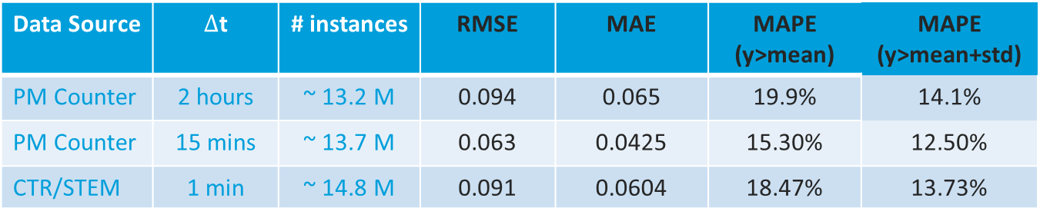
Cell Load Prediction (2): experiment and evaluation
Data Source | $∆$t | # instances | RMSE | MAE | MAPE (y>mean) | MAPE (y>mean+std)
PM Counter | 2 hours | ~ 13.2 M | 0.094 | 0.065 | 19.9% | 14.1%
PM Counter | 15 mins | ~ 13.7 M | 0.063 | 0.0425 | 15.30% | 12.50%
CTR/STEM | 1 min | ~ 14.8 M | 0.091 | 0.0604 | 18.47% | 13.73%
For longer horizon of 120 mins, DeepAuto showed upto 32% reduction in RMSE compared to naive method, 4% improvement over XGBoost.
For short horizon of 15 minutes the gains compared to other methods are reduced.

Slide 10
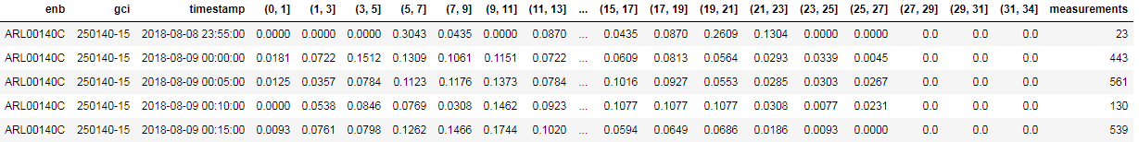
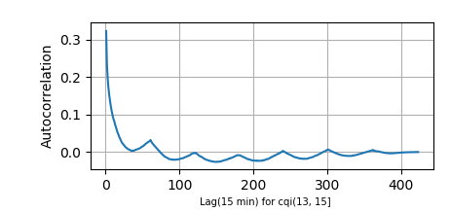
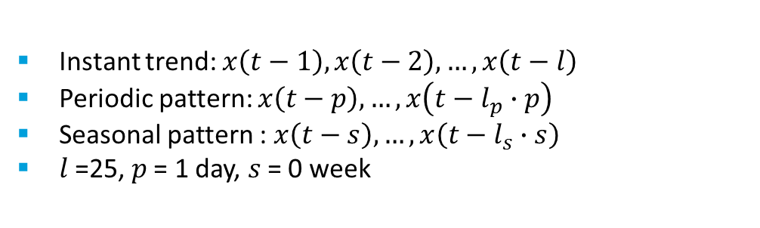
RF prediction (1)
The reported RSRQ values are grouped by timestamp (at 5-mins interval) and cell id, and binned into 17 buckets.
Snapshot of the data for prediction
RSRQ PDF :
% of RSRQ measurements in each bin (17 bins in total)
Temporal and external features:
Histogram of RSRQ
Day of week, Hour of day
Minute of day
Instant trend: $x\left(t−1\right),x\left(t−2\right),…, x\left(t−l\right)$
Periodic pattern: $x\left(t−p\right), …, x\left(t−l_{p}∙p\right)$
Seasonal pattern : $x\left(t−s\right), …, x\left(t−l_{s}∙s\right)$
$l$=25, $p$ = 1 day, $s$ = 0 week
1 day
*note: correlation artifact due to non-continuous data

Slide 11
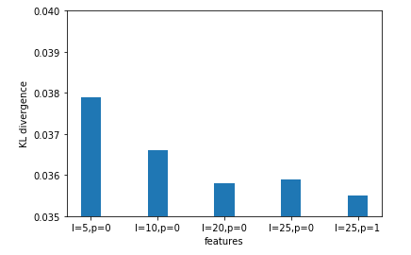
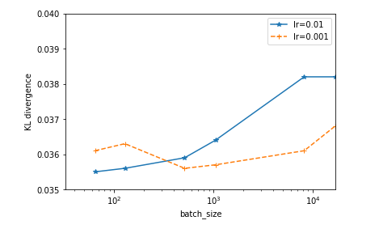
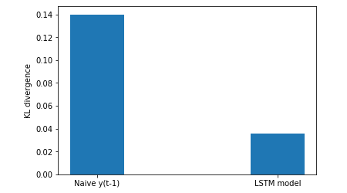
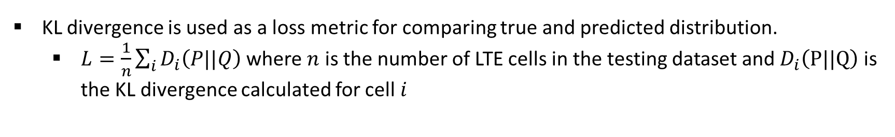
RF prediction (2): experiment and evaluation
KL divergence is used as a loss metric for comparing true and predicted distribution.
$L=\frac{1}{n}\sum_{i}{D_{i}\left(P||Q\right)}$ where $n$ is the number of LTE cells in the testing dataset and $D_{i}\left(P||Q\right)$ is the KL divergence calculated for cell $i$
*Traditional statistical/machine learning methods seem unsuitable for this problem. Thus, baseline performance is not provided for other methods
DeepAuto achieved 75% improvement compared to naive method

Slide 12
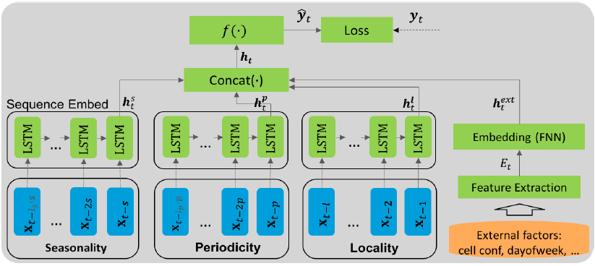
Concluding remarks
Goal
Design scalable
Reusable prediction system
DeepAuto
A deep learning framework to predict RAN KPI with various time horizons
Evaluation
Models show advantage in capturing complex relationships
Accurate forecasting of RAN KPIs represents an essential part LTE/5G RAN automation. We provided an unified, efficient and effective traffic prediction architecture that predicts various RAN KPIs in real time.
We presented the prediction model DeepAuto, hierarchical deep learning framework, that constructively captures spatial, temporal and external factors, as well as network configuration changes in a scalable manner.
Machine learning methods reduce the prediction error by upto 75% compared to the naive method of using recent measurement.

Slide 14
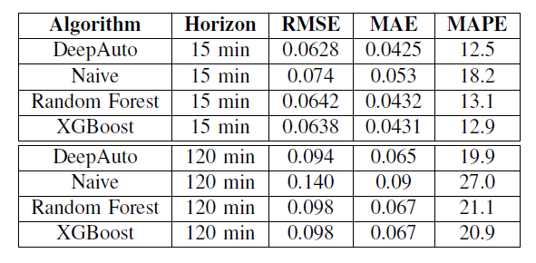
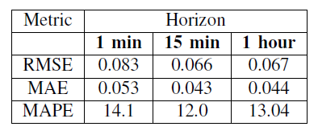
Results
DeepAuto performs superior compared to other baseline methods in all metrics considered. For 15 min horizon, DeepAuto showed upto 15% improvement in RMSE compared to naive method, 2.5 % improvement compared to random forest and 1.5% improvement compared to XGBoost.
Naive method of using yt􀀀1 as prediction resulted in KL divergence of 0.14 while DeepAuto achieved a KL divergence value of 0.0353 (over 75% improvement compared to naive method).

Slide 15

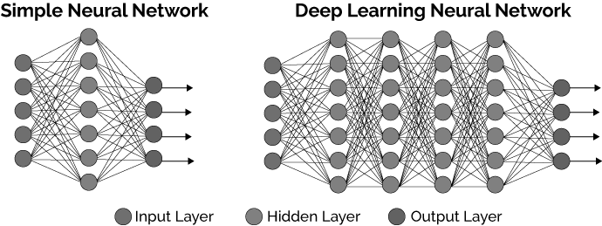



Deployment
Training phase
Data Sources
eNBs
Batched/
offline data
Batch processing
Build model
file based
Model update
Prediction phase
Kafka API
Stream processing
Prediction
every 1 min
for all cells
Prediction
Microservice
Apps

